Slide 1

VSTA
Vessel Schedule Tracking Application
By G1T9, For PSA

Slide 2
AGENDA
01
02
03
04
Architecture Diagram
Libraries Used
Overview & walkthrough of components
Tools used for our implementation
Design Principles
Application Demo
How we layered & designed the application
How to start our app & walkthrough of features

Slide 3
01
Architecture Diagram
Overview & walkthrough of components

Slide 4
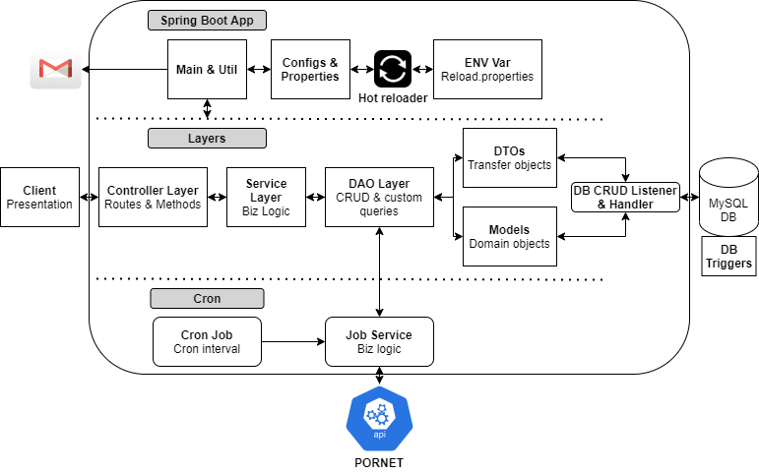

Architecture diagram: Overview
Notes:
This is the overview of our arch diagram. Now i will quickly run through how we implemented the different components.

Slide 5
Architecture diagram: Utility & Properties
Notes:
At the top, lies the reusable components namely utility classes, configs and environment properties.
Externalized properties and reloadable

Slide 6
Architecture diagram: Layers
Notes:
To adhere to the srp and reduce coupling, broken components into layers.
Models:
As far as we could, we tried to use a dedicated model object for each different task to reduce coupling
Used database triggers to count no of times berth time changed

Slide 7
Architecture diagram: Cron Job
Notes:
Db listener that intercepts database update events and sends an email if any details changed

Slide 8
02
Libraries Used
Tools used for our implementation
Notes:
After going through what we have implemented, next we have the tools we used in our implementation.

Slide 9

Notes:
We chose to use the spring boot framework.

Slide 10
Why Spring Boot?
Flexibility and convenience
Auto Configuration
Easier way to manage processes
REST endpoints
Interact with database
Pre-packaged starter kits to bypass the need of:
Sourcing the different dependencies
Finding which versions are compatible
Notes:
This is because it provides a lot of flexibility and convenience.
There is auto configuration in place and
many processes may be more easily and elegantly handled.
There are also pre-packaged starter kits which help us bypass the need of sourcing the different dependencies and finding which versions are compatible.

Slide 11
Libraries
Spring Data JPA for interacting with the database
Extra layer of abstraction on top of the Java Persistence API provider
Allow custom implementations that reduces boilerplate code
Quartz to schedule the execution of jobs
Automation of support tasks
Provide timely service
Security for authorisation
Enabled basic authentication for API using credentials and headers
Protect against unauthorized access and cyber attacks
Mail for email sending support
Notifications for vessel subscriptions
Communicate information e.g. password reset token
Notes:
starting with the starter kits,
we used spring data java persistence api to interact with the database as it allows for a lot of custom implementations that reduces the boilerplate code needed.
quartz is used to schedule and automate the timely execution of jobs.
We also enabled the basic authentication of Spring Security to secure the APIs from unauthorized access and attacks.
finally, we used spring mail for notifications and the password reset functionality.

Slide 12
Libraries
Apache HttpComponents HTTP client for working with HTTP requests
Store API key in HTTP header
Factory to store configuration details e.g. timeout
Jackson for JSON serialization/deserialization
Conversion between Java Objects and JSON Strings
Notes:
other than the starters, we also looked at handling http requests with http client. we used it to pass the API key in the headers and configure timeout.
We also used jackson to support the conversion between java objects and the JSON responses.

Slide 13
Libraries
Annotations to write less repetitive code
Javax Validation
E.g. NotBlank, Email
Enforces validity before storing into the database
Project Lombok
E.g. Cleanup, Data
Cleanup: ensure reader of configurations automatically closed
Notes:
finally, we made use of annotations to write less repetitive code.
it was used to enforce validations or perform cleaning up.

Slide 14
03
Design Principles
How we layered & designed the application
Notes:
next we talk about the thought process behind our code structure.

Slide 15
Design & Architecture Stack
Architectural Style
Layered
Design Pattern & Principles
Factory, Single Responsibility Principle
Object-Oriented Programming
Inheritance, Polymorphism, Encapsulation
Programming Paradigms
Mixture of Structured, Functional & Object Oriented
Clean Code
Clear Naming, Structure, Consistency, Readability

Slide 16
Architectural Style
Layered.
Components are organized in horizontal layers, each performing a specific role.
E.g. Adding voyage to favourite
Presentation Layer
User Screen
Controller
Service Layer
Favourite Service
Persistence Layer
Favourite
DAO
Database Layer
Database

Slide 17
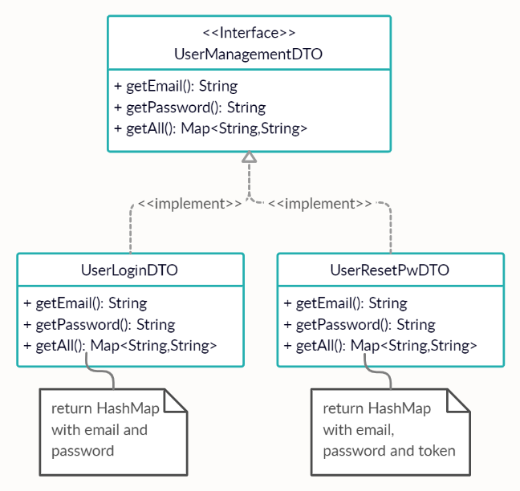
Design Pattern and Principles
Single Responsibility Principle.
A class should only have one responsibility.
E.g. Functionalities for User are splitted
(login and reset password)
Factory Design Pattern.
Provide interfaces for creating objects
in a superclass, but allow subclasses to alter the type of objects to be created.

Slide 18
Object-Oriented Programming
Inheritance. Extends the following:
CRUDrepository for generic CRUD operation for a specific type
JPArepository for extra methods such as delete records in batch & flushing data directly to a database for our DAOs
Polymorphism. Practice different types of polymorphism:
Compile time Polymorphism. Overloaded sendEmail function for notification
Runtime Polymorphism. Overrided setApplicationContext from SpringBeanJobFactory to inject spring beans from application context
Encapsulation: Methods are declared private if it is only called within the class.
E.g. validations methods for classes are private.

Slide 19
04
Application Demo
How to start our app & features walkthrough

Slide 20
THANK YOU
Questions?
Please keep this slide for attribution

